Slide 1
Renovation of Alison and Napier Boarding Houses Trinity College Kandy

Slide 2
Trinity College with an exceptional historical background in the education arena in Sri Lanka, has had a significant Boarding system in the past. Napier House was the first boarding house at Trinity with many to follow with the increase of its student population.
However, the houses and their condition have reached a remorseful state with age, and it is a must to rejuvenate these houses to bring the old glory and excitement of being a boarder at Trinity.

Slide 3
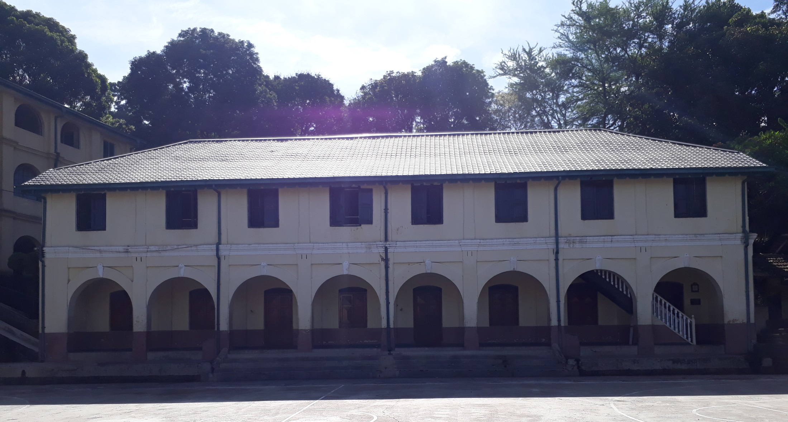
Current situation – Napier House

Slide 4
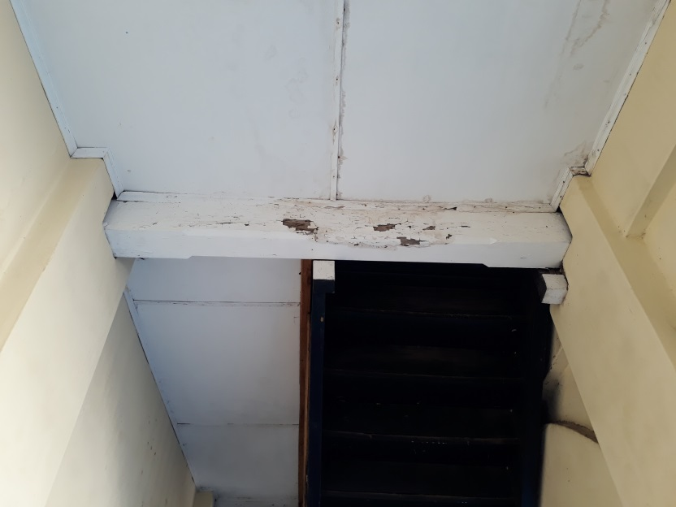
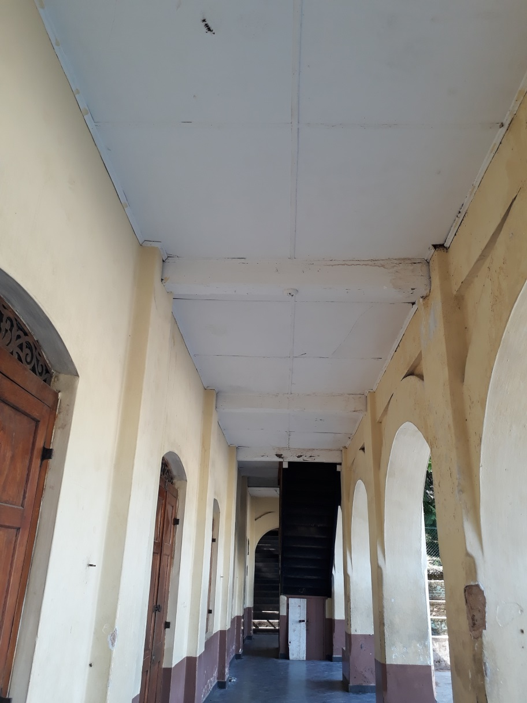
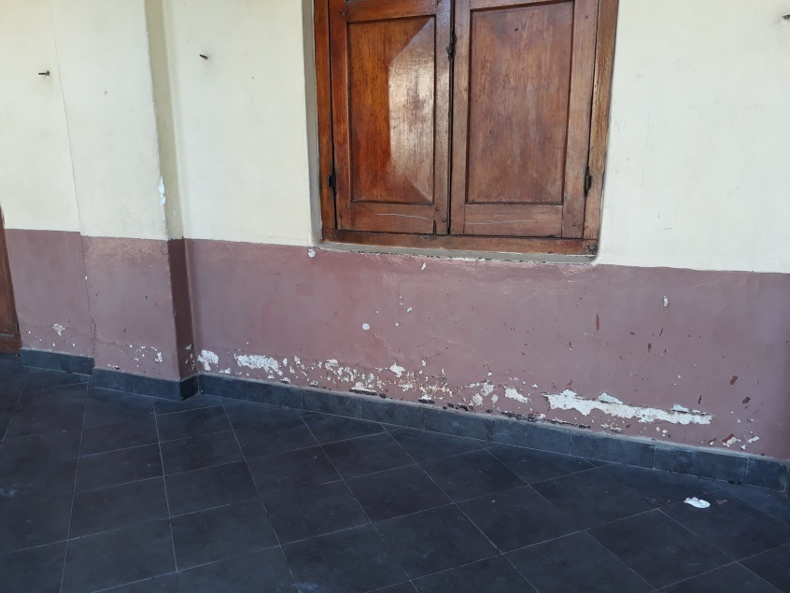
Current situation – Napier House

Slide 5
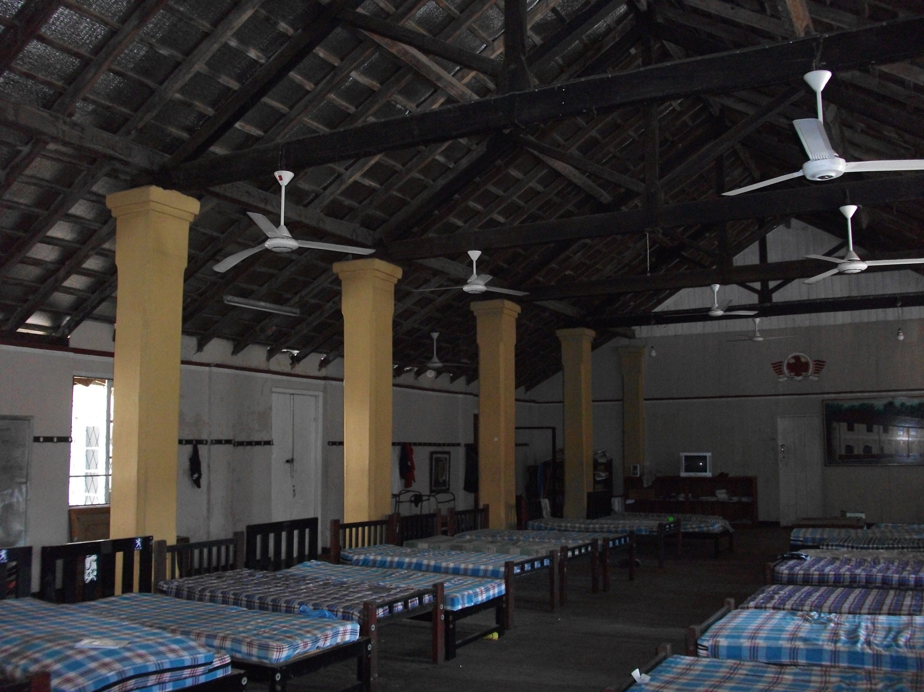
Current situation – Napier House

Slide 6
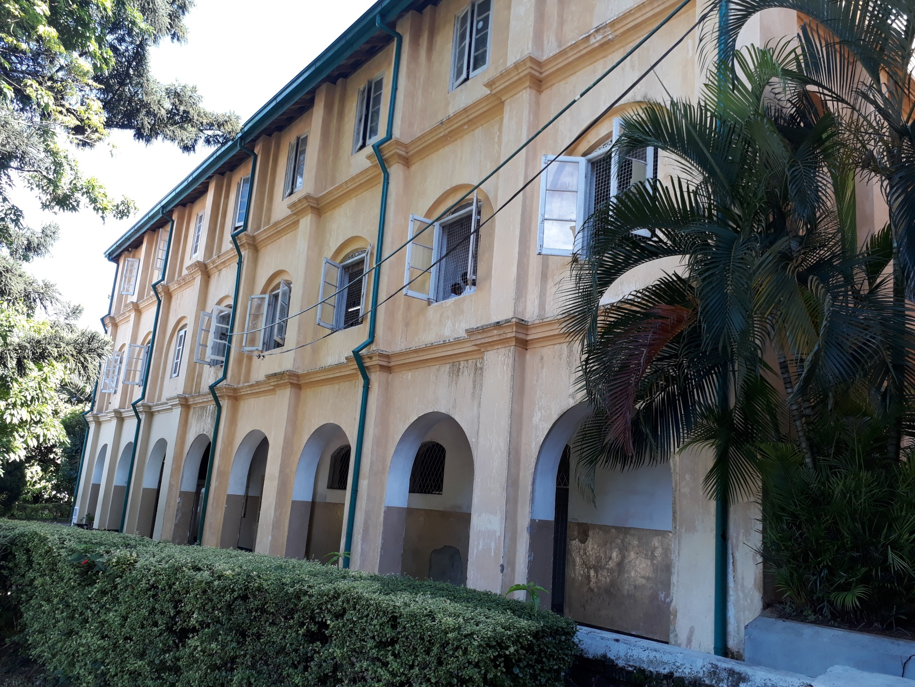
Current situation – Alison House

Slide 7
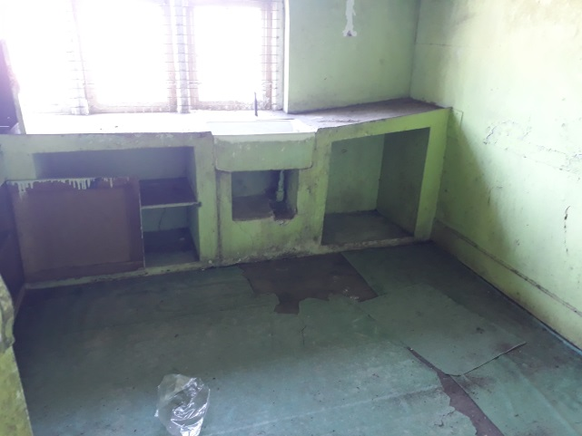
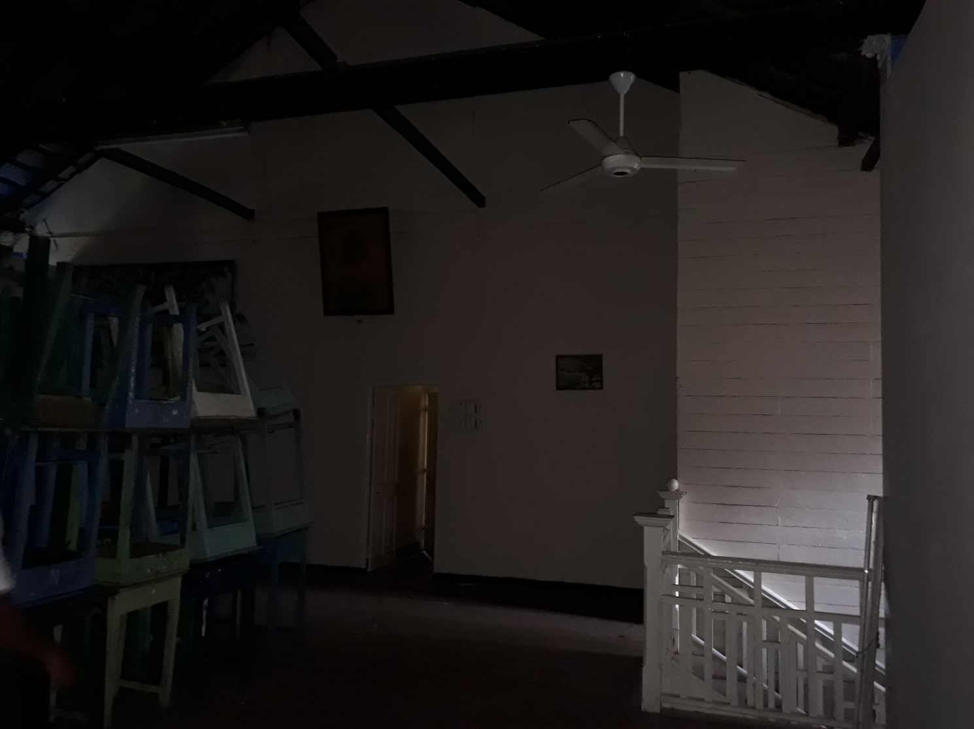
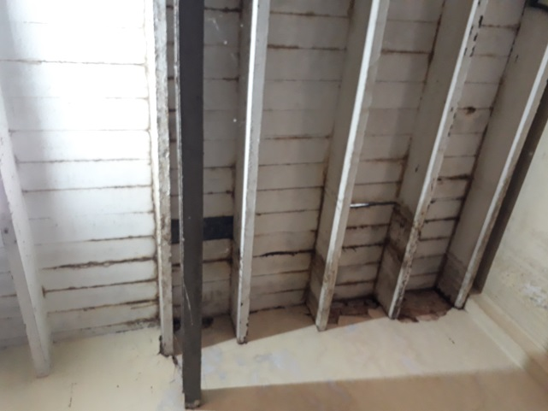
Current situation – Alison House

Slide 8
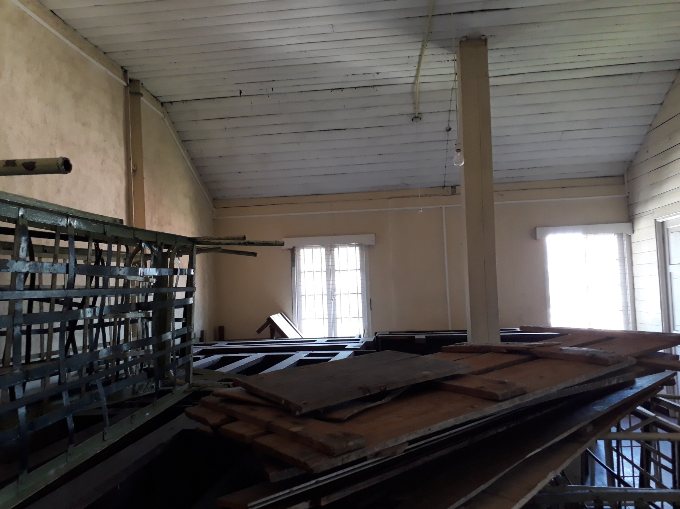
Current situation – Alison House

Slide 9
Design Concepts
Introduction of house parents to the boarding house – A qualified couple with experience in boarding to be housed in each building who will look after the boarders, along with a tutor in each house, which would create a homely atmosphere.
Weekly boarding system – The College anticipate in the future that most of the children will be housed as weekly boarders, arriving at the boarding on Monday and leaving to their respective homes on Friday. A transportation system will be arranged by the college to pick them from and drop them in Colombo.
A room system of accommodation instead of a dormitory system to maintain personal space and privacy.

Slide 10
Design Approach
Room based design – The number of boarders in one room may vary from a maximum of 6 to a minimum of 1.
Each boarder will have an individual study area with a bunk bed on top.
Common areas – Flexible spaces, convertible spaces, loose furniture.
Enclosed study rooms for tutoring and separate rooms for leisure.
Internal access from one floor to the other via steel stairs.
Toilet and washroom facilities provided in each floor.
Option of bringing natural light in to the building with skylights.
Use of timber and steel as primary building materials.

Slide 11
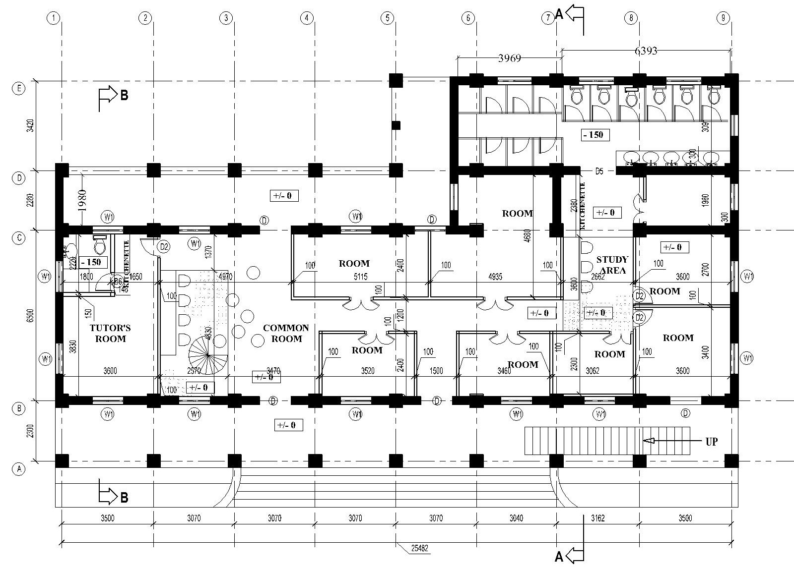
Napier House – Ground Floor Layout

Slide 12
Napier House – First Floor Layout

Slide 13
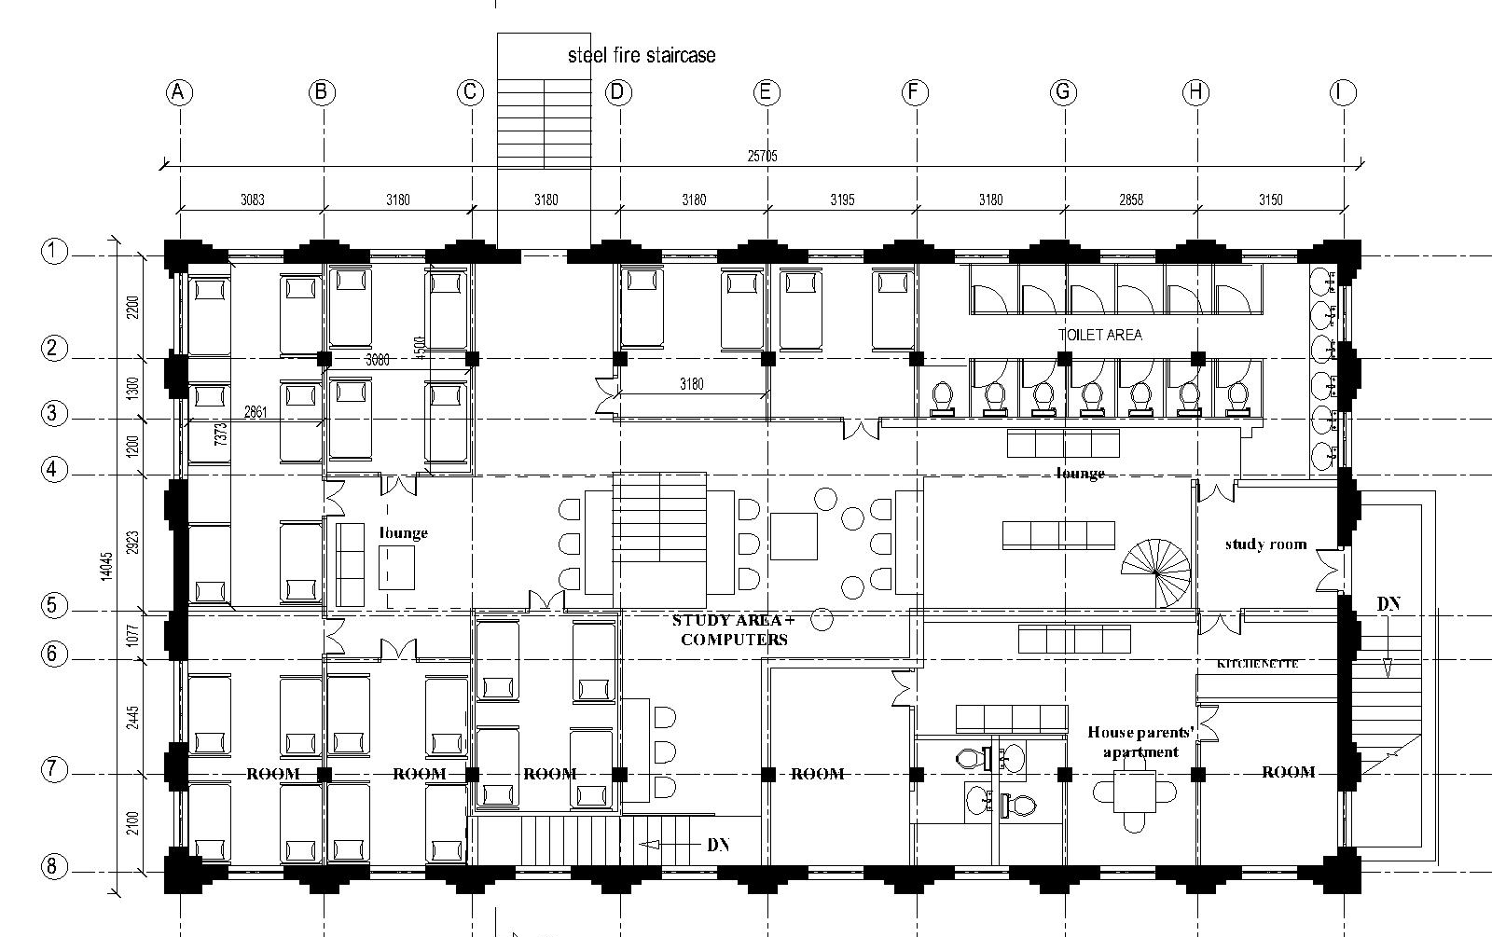
Alison House – First Floor Layout

Slide 14
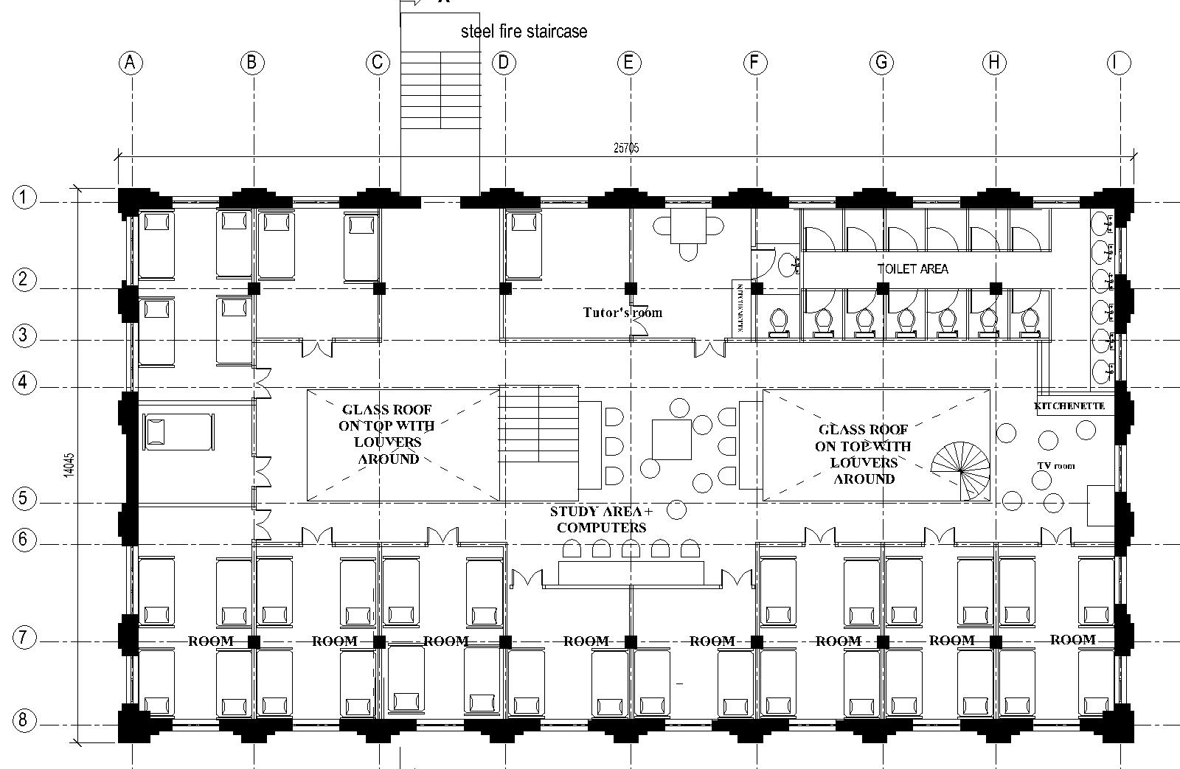
Alison House – Second Floor Layout

Slide 15
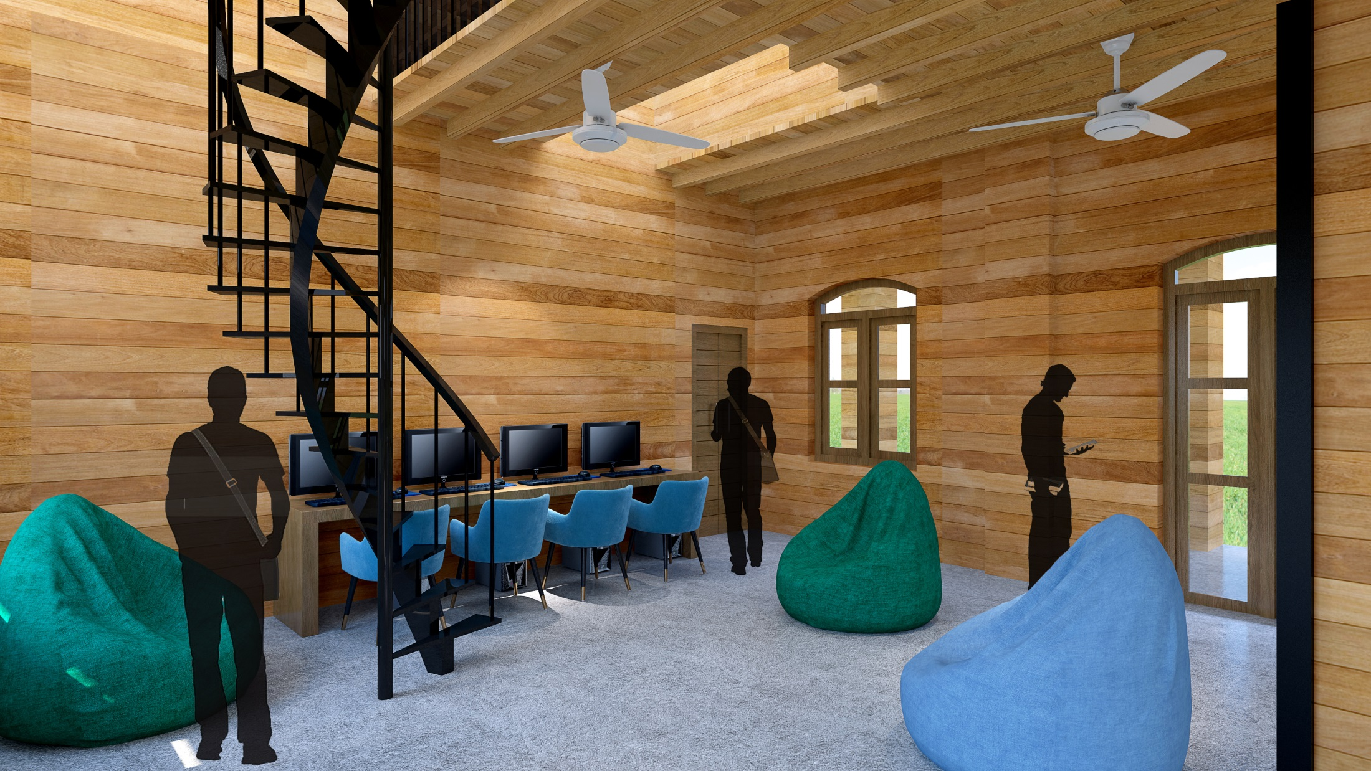
3 Dimensional Imagery – Napier House

Slide 16
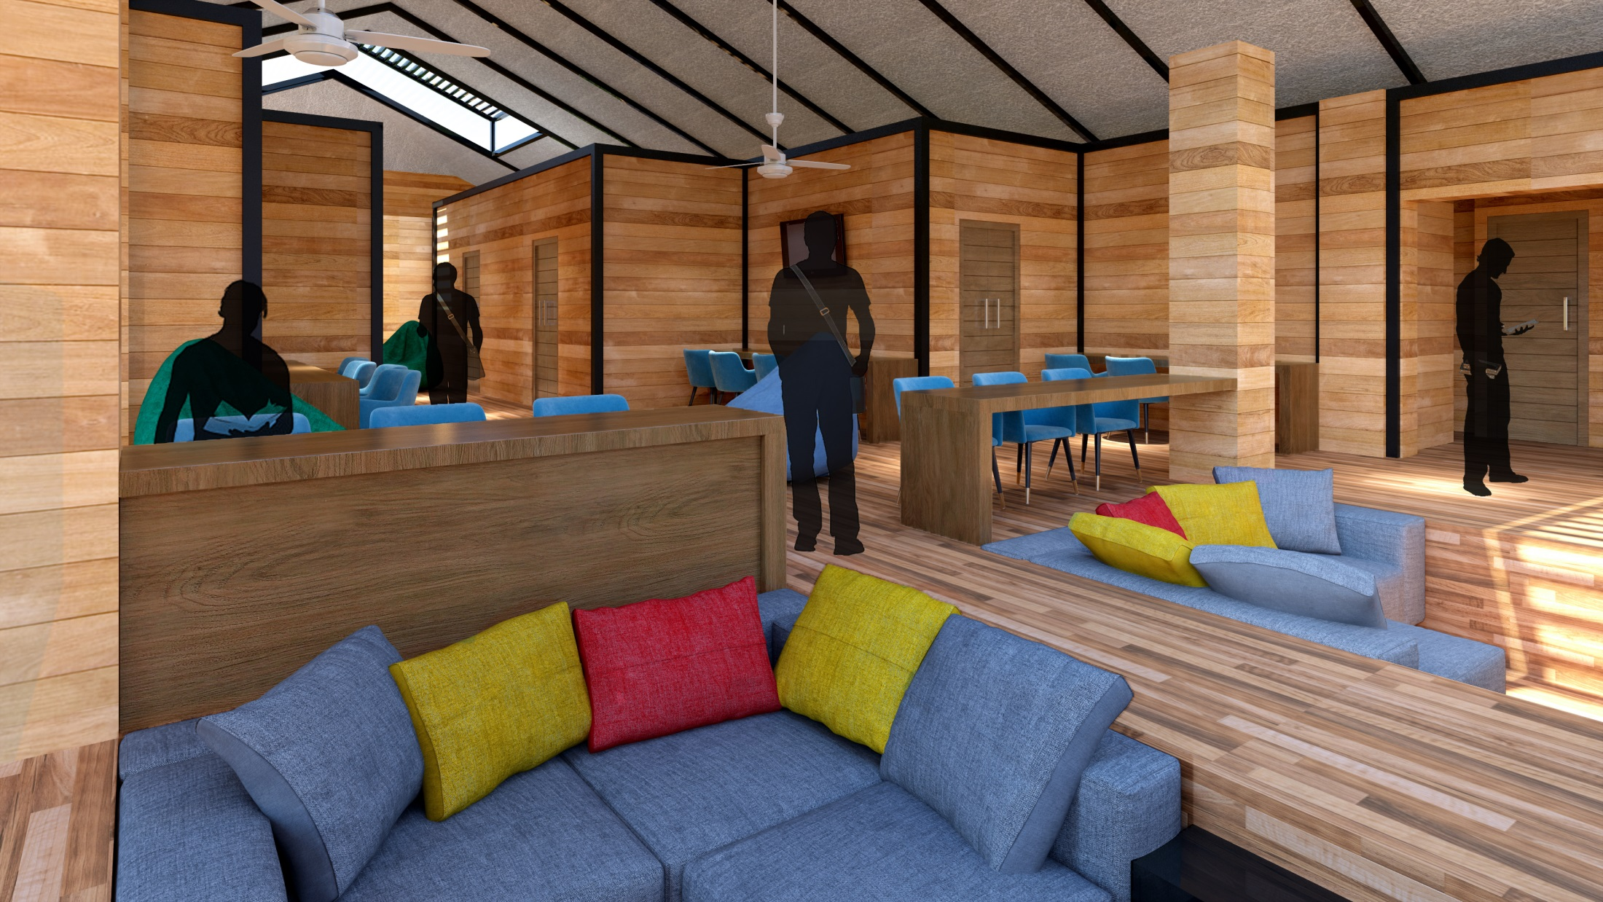
3 Dimensional Imagery – Napier House

Slide 17
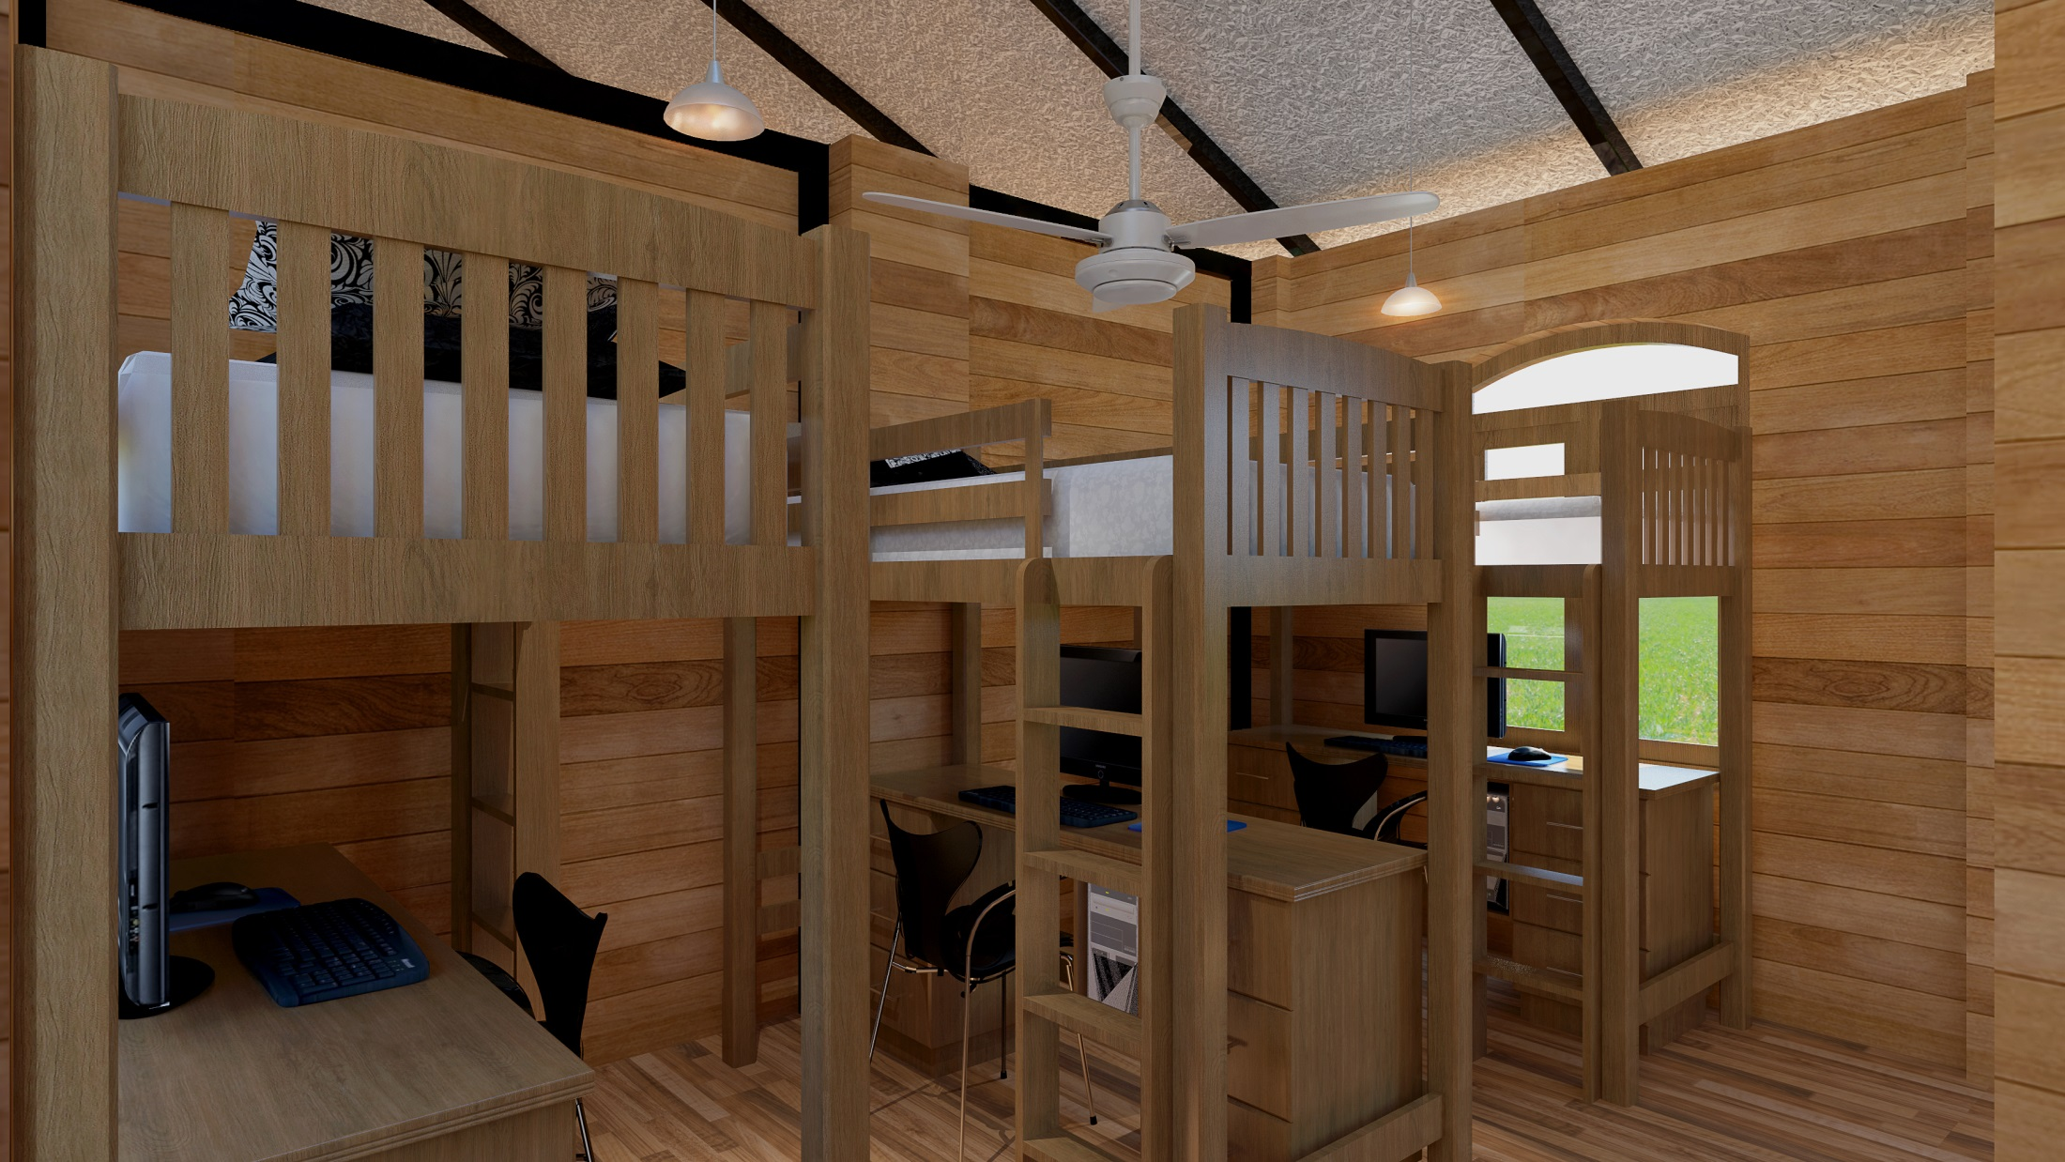
3 Dimensional Imagery – Napier House

Slide 18
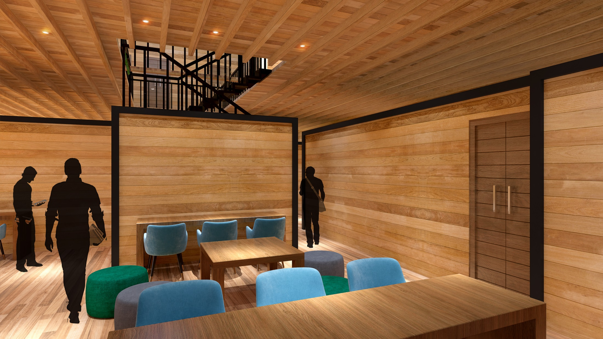
3 Dimensional Imagery - Alison House

Slide 19
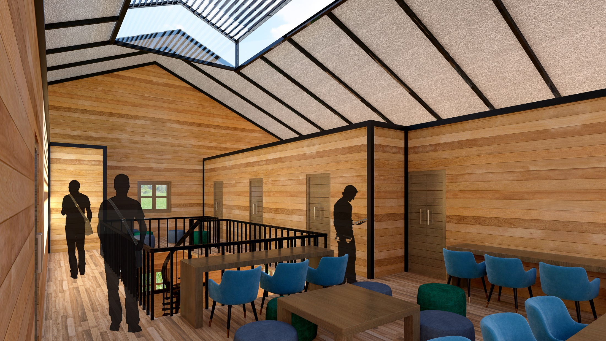
3 Dimensional Imagery - Alison House

Slide 20
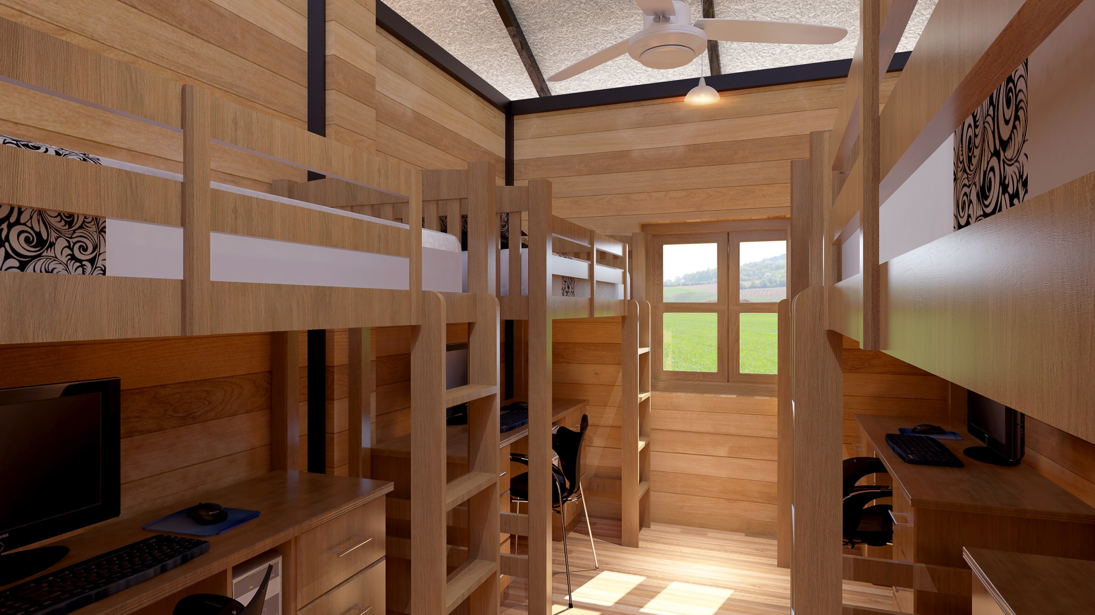
3 Dimensional Imagery - Alison House

